Slide 1
Spring Batch 3.0 Webinar
Michael Minella, Project Lead – Spring Batch, Pivotal
@michaelminella

Slide 2


WHAT HAS
SPRING BATCH
DONE FOR ME LATELY

Slide 3


Michael Minella
Twitter: @michaelminella
Spring Batch
Home: http://projects.spring.io/spring-batch/
Github: http://github.com/spring-projects/spring-batch
Jira: https://jira.spring.io/browse/BATCH

Slide 4


http://github.com/mminella/SpringBatchWebinar

Slide 5


Slide 6


JSR-352

Slide 7



+
=

Slide 8

BIG
REAL-TIME
GEMFIRE
AMBARI
GROWING
YARN
HAWQ
SQOOP
HBASE
STORM
INTERNET OF THINGS
PETABYTE
MAP REDUCE
DATA
PIVOTAL HD
MAHOUT
FLUME
RECOMMENDATIONS
HIVE
SPARK
OOZIE
HADOOP
SPRING
PIG

Slide 9
JSR-352

Slide 10
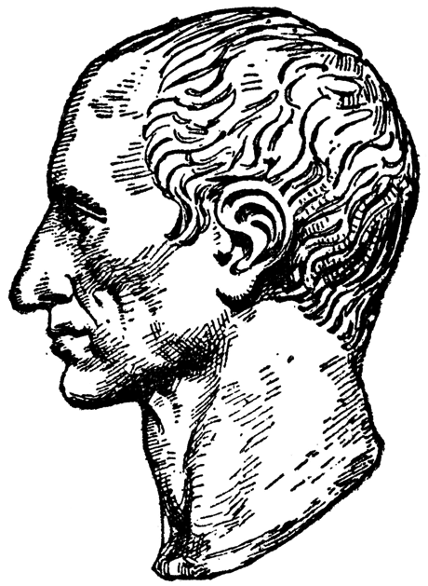
JSR-352 introduces an exciting new Java
specification for building, deploying, and
running batch applications.
- Chris Vignola

Slide 11

Over 6 years of
production experience

Slide 13
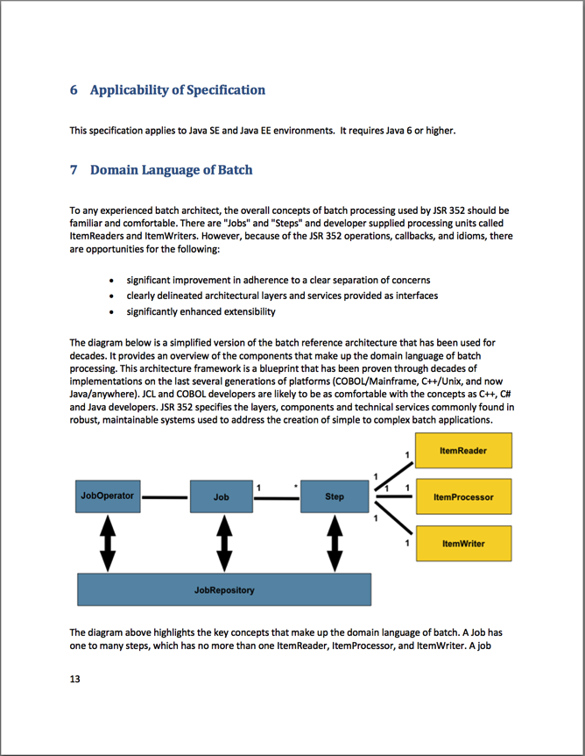
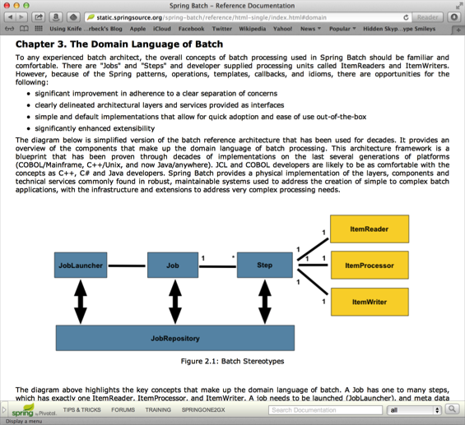

Slide 14

Structurally, JSR-352 and Spring Batch
are similar

Slide 15
11
14
7
12
20
16
5
17
6
3
2
8
18
13
4
1
10
19
23
15
9

Slide 16
1
API

Slide 17
2
DSL

Slide 18
3
CONTRACT

Slide 19

JSR-352 is a specification…
not an implementation

Slide 20
SPRING BATCH 3.0

Slide 21

100% JSR-352
COMPLIANT

Slide 22
System.out.println(“Hello World!”);

Slide 23

NO DEPENDENCY
INJECTION REQUIRED

Slide 24

OPTIONS
DEPENDENCY
INJECTION

Slide 25
<!– Inline -->
<batchlet ref=”io.spring.MyBatchlet”/>

Slide 26
<!– batch.xml-->
<batch-artifacts>
<ref id=”myArtifact"
class=“io.spring.MyArtifact"/>
</batch-artifacts>

Slide 27
<!– Spring DI-->
…
<bean id=“batchlet”
class=”io.spring.MyBatchlet”/>
…

Slide 28
FILE
DATABASE

Slide 29

BATTLE TESTED
COMPONENTS

Slide 30

JSR-352
IS A SUBSET OF
SPRING BATCH

Slide 31
1
LAUNCHING

Slide 32
2
JAVA
CONFIGURATION

Slide 33
3
INHERITENCE

Slide 34
4
TYPE SAFE
PROPERTIES

Slide 35
5
SCALABILITY

Slide 36
6
SPRING!

Slide 37


Slide 38
+
=

Slide 39
“ARCHETYPES”
RC
P

Slide 40

SPRING BOOT
SPRING OPINIONATED

Slide 41

SPRING BOOT MAKES STARTUP
EASIER

Slide 42
FILE
DATABASE
NOW
WITH
MESSAGING!

Slide 43

LAUNCHING AND
STATUS UPDATES

Slide 45
BIG
REAL-TIME
GEMFIRE
AMBARI
GROWING
YARN
HAWQ
SQOOP
HBASE
STORM
INTERNET OF THINGS
PETABYTE
MAP REDUCE
DATA
PIVOTAL HD
MAHOUT
FLUME
RECOMMENDATIONS
HIVE
SPARK
OOZIE
HADOOP
SPRING
PIG

Slide 46

SPRING XD
BIG DATA SIMPLIFIED

Slide 47

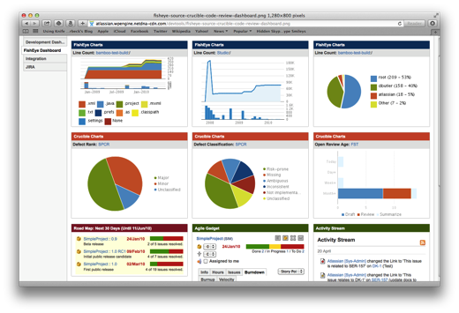





Ingestion
Orchestration
SPRING
Extraction
Real-time
Analytics
Notes:
Spring XD handles everything in the circle

Slide 48
BIG
REAL-TIME
GEMFIRE
AMBARI
GROWING
YARN
HAWQ
SQOOP
HBASE
SQOOP
STORM
INTERNET OF THINGS
PETABYTE
MAP REDUCE
MAP REDUCE
DATA
MAHOUT
FLUME
PIVOTAL HD
MAHOUT
RECOMMENDATIONS
HIVE
HIVE
SPARK
OOZIE
OOZIE
HADOOP
SPRING
PIG
PIG

Slide 49

SPRING XD
BATCH JOBS
RUNNING ON

Slide 50

The
End

Slide 51

Learn More. Stay Connected.
Spring Batch
Project: spring.io/spring-batch
Github: github.com/spring-projects/spring-batch
Jira: jira.spring.io/browse/BATCH
Spring Boot
Project: spring.io/spring-boot
Github: github.com/spring-projects/spring-boot
Spring XD
Project: spring.io/spring-xd
Github: github.com/spring-projects/spring-xd
Jira: jira.spring.io/browse/XD
Twitter: twitter.com/springcentral
YouTube: spring.io/video
LinkedIn: spring.io/linkedin
Google Plus: spring.io/gplus

Slide 52












Increase by Attilio Baghino from
The Noun Project
Question by Jessica Lock from
The Noun Project
Servers by Jaime Carrion from
The Noun Project
Twitter by Maria Maldonado from
The Noun Project
Running by Dillon Arloff from
The Noun Project
Syringe by Gilad Fried from
The Noun Project
List by Agus Purwanto from
The Noun Project
Arrows by Juan Pablo Bravo from
The Noun Project
Tank by Renan Ferreira Santos from
The Noun Project
Hammock by Adam Mullin from
The Noun Project
Architect by Luis Prado from
The Noun Project
Database by Anton Outkine from
The Noun Project

